Slide 1
Authentication and Authorization in Node.js

Slide 2
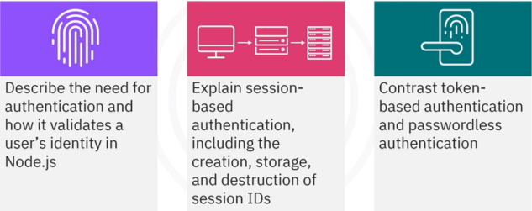
What you will learn

Slide 3

Introduction
• E-commerce platform
• Authentication and authorization
are not robust
• Data breaches possible
Learn Node.js authentication and
authorization
• Secure user authentication
• Safeguard sensitive data
• Enhance app reliability and user
satisfaction

Slide 4

Understanding authentication
• Verifies a user's identity using
credentials
• Ensures only authorized users
access the system
• Handles the verification via back
end

Slide 5
Popular authentication methods in Node.js
Session
based
Token
based
Passwordless

Slide 6
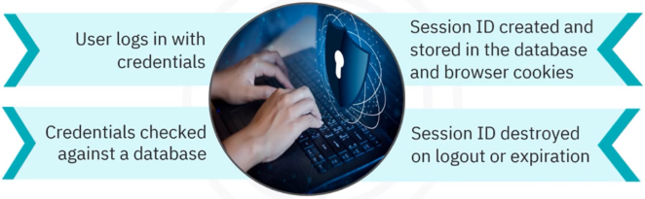
Session-based authentication

Slide 7
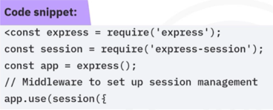
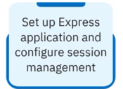
Session-based authentication in an Express application

Slide 8
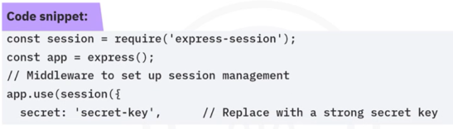
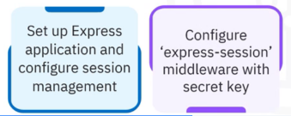
Session-based authentication in an Express application

Slide 9
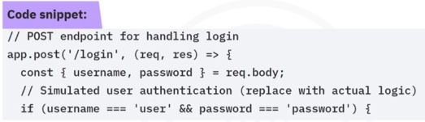
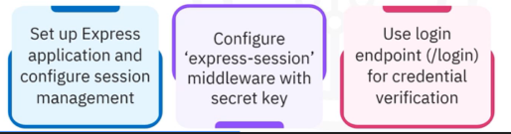
Session-based authentication in an Express application

Slide 10
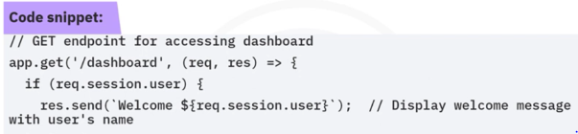
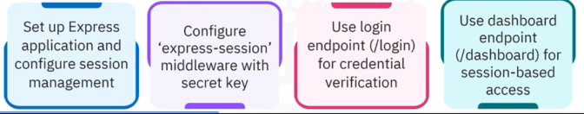
Session-based authentication in an Express application

Slide 11

Token-based authentication
Authentication
user gets a token
Authorization: Token Used
to access resources

Slide 12
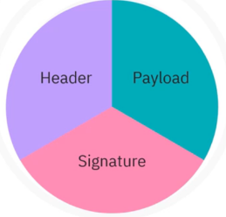
Token-based authentication
Tokens contain three parts:

Slide 13

Token-based authentication
How token-based authentication works
• Browser calls an authentication server
• Server provides access to a web
application
Authentication server returns an ID
token
• Client stores ID token as an encrypted I
cookie
ID token is passed to the web server app
Token serves as proof of authentication

Slide 14

Token-based authorization
• Authorization: Protects resources from unauthorized
access
• Authentication: User verifies identity with the authorization
server

Slide 15
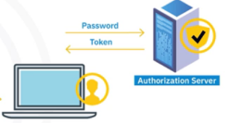
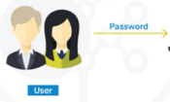
Token-based authorization
• Access token: Created by server; distinct from ID token
• Storage: Token stored
on the client's device

Slide 16


Token-based authorization
• Using the token: Sent with each request to access resources
• Permissions info: Token contains user permissions without the
need for permissions from the authorization server
• Security feature: Token encryption protects user credentials

Slide 17

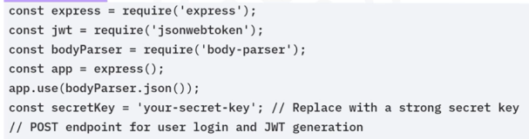
Token-based authentication in an Express application
Express setup

Slide 18
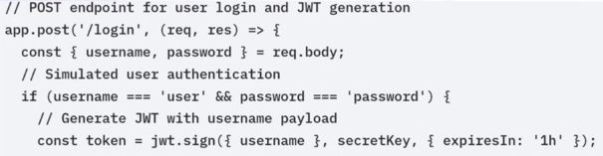
Token-based authentication in an Express application
Express setup
JWT generation (/login)

Slide 19
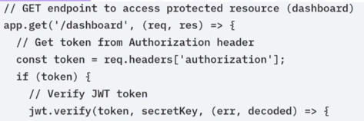
Token-based authentication in an Express application
Express setup
JWT generation (/login)
JWT verification (/dashboard)

Slide 20

Passwordless authentication
• No traditional passwords needed
• Uses biometrics, magic links, or
one-time passcodes
• Utilizes public/private key
encryption for security

Slide 21
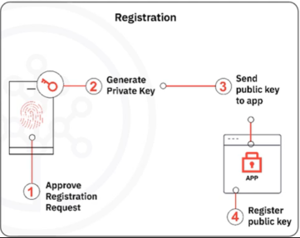
Passwordless authentication
• Device generates a private
key/public key pair
• Pair utilizes a factor to prove
your identity
• Public key is available to
anyone
• Public key encrypts data
• Private key is securely stored
on your device
• Private key decrypts data

Slide 22
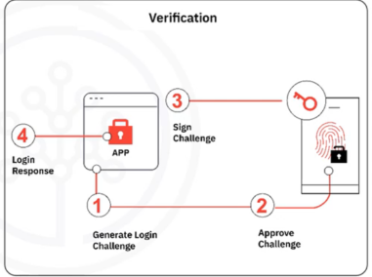
Passwordless authentication
• Application generates a
login challenge
• Challenge is encrypted with
the public key
• Private key decrypts the
challenge
• Response is used to
authorize the user

Slide 23

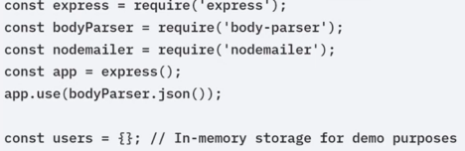
Passwordless-based authentication in an Express application
Express application setup with JSON requests parsing middleware

Slide 24
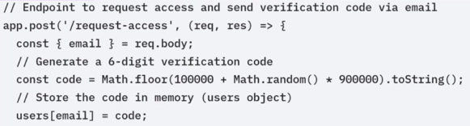
Passwordless-based authentication in an Express application
Express application setup with JSON requests parsing middleware
/Request-access: Generates and stores a verification code

Slide 25
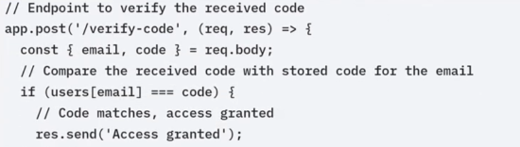
Passwordless-based authentication in an Express application
Express application setup with JSON requests parsing middleware
/request-access: Generates and stores a verification code
/verify-code: Verifies code and grants/denies access

Slide 26
Recap
In this video, you learned:
• Authentication confirms a user's identity using credentials.
• Session-based authentication involves creating a session ID that is stored
both in the database and the client's browser.
• Token-based authentication uses JWTs to securely transmit user
information between client and server.
• Passwordless authentication uses public/private key pairs to authenticate
users without traditional passwords.

